Slide 1
Blood Camp management system
Project by:
Chaitanya Yuvraj Patil(2019BCS)
Jayesh Raju Akot(2019BCS137;A66)

Slide 2
Software used:
Pycharm : For designing Frontend
pyQt5 : For designing user interface and Frontend
MySQL Workbench : For handling Backend and database.

Slide 3
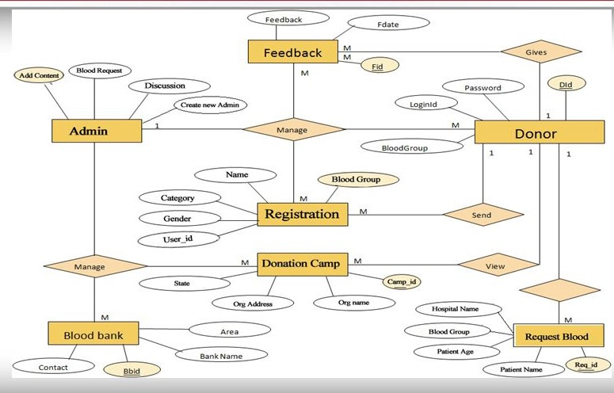
ER diagram

Slide 4
Features:
Blood Donation Camp & Camp Organiser Management.
Donor Management – Donor Registration, Managing donor database, recording their physical and medical statistics.
Inventory management in blood bank for storage and issuance of blood.
Blood requisition and issuance of blood.
Online transfer of blood from one blood bank to another.
Discarding of expired and unsuitable blood (Less Qty., Reactive, Clotting, Hemolysis).
Being a web-based system can be implemented throughout the state. Separate user accounts can be created for each blood bank.
Patient Register/Blood Sample Receiving Register, Donor Register, Blood Issue Register and Discarded Blood report.
Fridge Wise Stock Position and Printing of Fridge Stickers.
List of Donors who are eligible for donation on a particular date with contact Number.
Camp Wise Donor List and Printing of Donor Cards.

Slide 5
References
1. Blood Transfusion Council, India, http://www.mahasbtc.com. Accessed on July 20 2017
2. Kim, S.J., Yoo, S.K., Kim, H.O., Bae, H., Park, J.J., Seo, K.J., Chang, B.C.: Smart blood bag management system in a hospital environment. Lecture Notes in Computer Science, 4217, 506 (2006)
3. Ali, A., Jahan, I., Islam, A., Parvez, S.: Blood donation management system. American J. Eng. Res. 4(6), 123–136 (2015)
4. Barbara, M., Katherine, M.W., Melissa, K.H., Deborah, J.T.: The psychology of blood donation: Current research and future directions. Transfus. Med. Rev. 22(3), 215–233 (2008)
5. Li, B.N., Dong, M.C., Chao, S.: On decision making support in blood bank information systems. Expert Syst. Appl. 34(2), 1522–1532 (2008)
6. Olaiya, M.A., Alakija, W., Ajala, A., Olatunji, R.O.: Knowledge, attitudes, beliefs and motivations towards blood donations among blood donors in Lagos. Nigeria Transfus. Med. 14, 13–17 (2004)
7. Devi, H.S., Laishram, J., Shantibala, K., Elangbam, V.: Knowledge, attitude and practice (KAP) of blood safety and donation. Indian Med. Gazette 145(1), 1–5 (2012)
8. Pyne, B., Kundu, S., Shanmuga, S., Iyengar, N.C.S.: A smart application on cloud based blood bank. J. Comput. Math. Sci. 7(11), 576–583 (2016)

